Slide 1


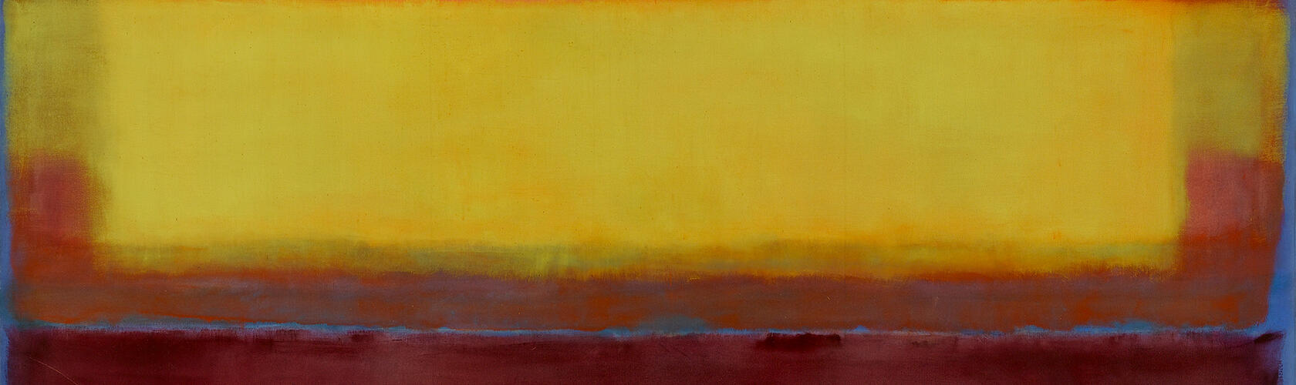

Slide 2
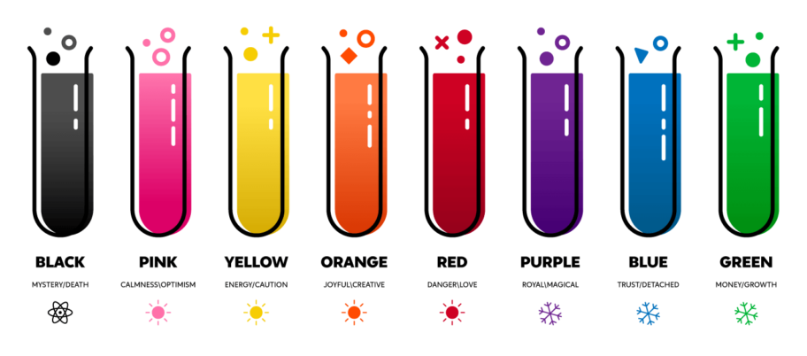
COLOUR AS CODE
Colour is one of the most emotionally and culturally charged tools available to artists. It can encode ideas without relying on text or imagery.
Colour can:
Symbolise emotional states (e.g., blue = calm/sadness, red = love/anger)
Indicate cultural beliefs (e.g., white = purity in Western cultures, mourning in India/green = life in Islam, death in South America)
Evoke memories and psychological responses
What colours do you emotionally connect to?
"Colour is a power which directly influences the soul." – Kandinsky

Slide 3
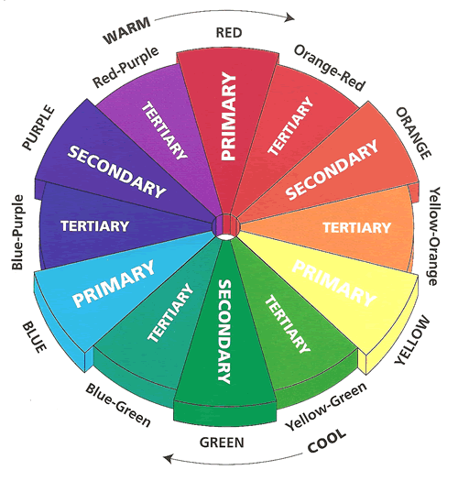
COLOUR THEORY
Primary Colours
The three base colours that cannot be made by mixing other colours: 🔴 Red, 🔵 Blue, 🟡 Yellow
All other colours are made by mixing these.
Secondary Colours
Made by mixing two primary colours: 🟢 Green (blue + yellow) 🟠 Orange (red + yellow) 🟣 Purple (red + blue)
Tertiary Colours
Made by mixing a primary colour with a neighbouring secondary colour, e.g.:
🔴 + 🟠 = Red-orange
🔵 + 🟢 = Blue-green
COLOUR THEORY
🔥❄️ Warm vs Cool Colours
Warm colours: red, orange, yellow – evoke warmth, energy, passion
Cool colours: blue, green, purple – evoke calm, peace, or sadness🎨
Complementary Colour Scheme: Colours opposite each other on the colour wheel (e.g. red & green). They are high in contrast and vibrant when placed side by side and used to create bold, dynamic compositions
🎨 Analogous Colour Scheme: Colours next to each other on the colour wheel (e.g. blue, blue-green, green). They are harmonious and calming, used for subtle transitions and unity
Tints, Shades & Saturation
Tint = base colour + white → makes the colour lighter
Shade = base colour + black → makes the colour darker
Saturation = intensity or purity of a colourHigh saturation = vivid, boldLow saturation = muted, greyed out

Slide 4
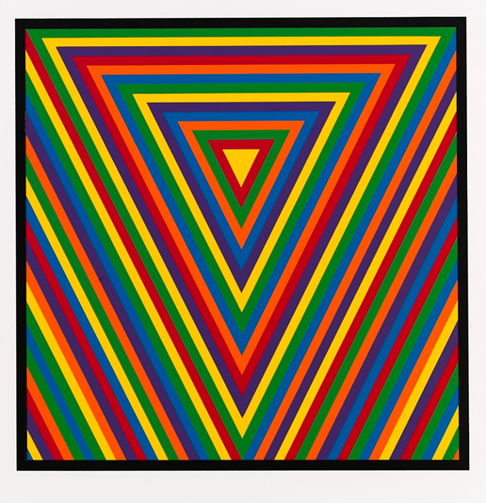
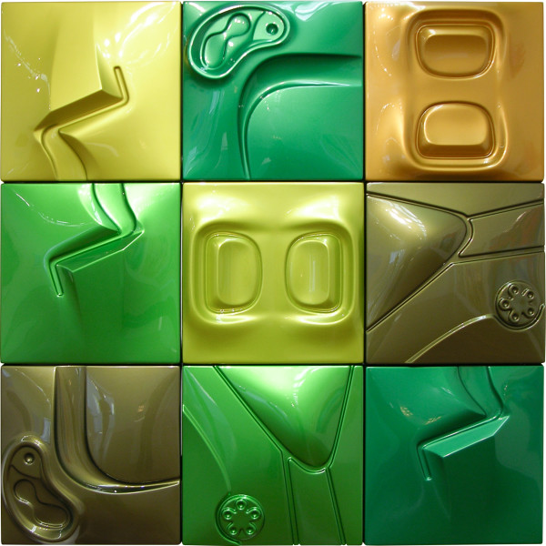
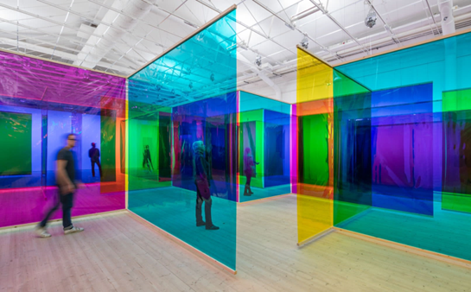
SOL LEWITT
Colour Bands, 2000, linocut on paper
Sol Lewitt uses colour and repetition as systems
OLAFUR ELIASSON
Reality Machines, 2016, installation
Olafur Eliasson creates immersive installations exploring colour and perception
https://www.youtube.com/watch?v=KE-Y3jJ4Lp8
PATRICIA PICCININI
Verdant, 2005, ABS plastic and automotive paint
Patrica Paccinini uses biological forms and colour for emotional impact

Slide 5
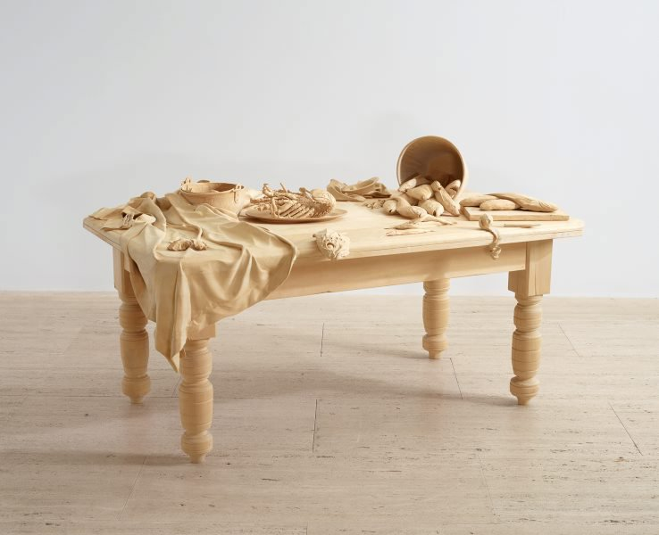
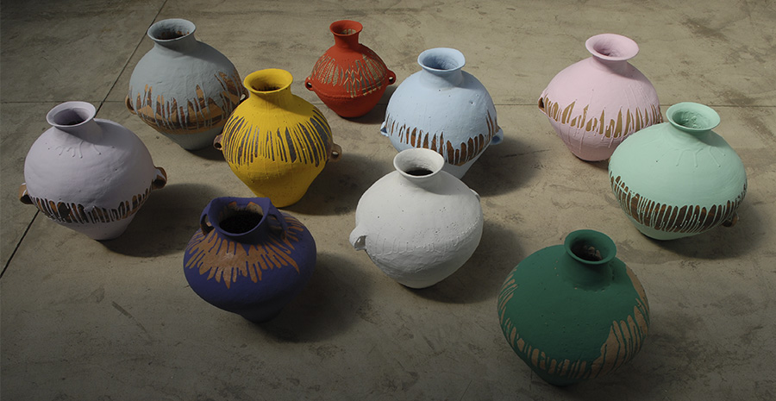
AI WEIWEI
Colored Vases, 2007, ten neolithic vases and industrial paint
Ai Weiwei uses colour to represent politics.
RICKY SWALLOW
Killing Time, 2003-2004, wood
Ricky Swallow uses symbolic form and hue.

Slide 6


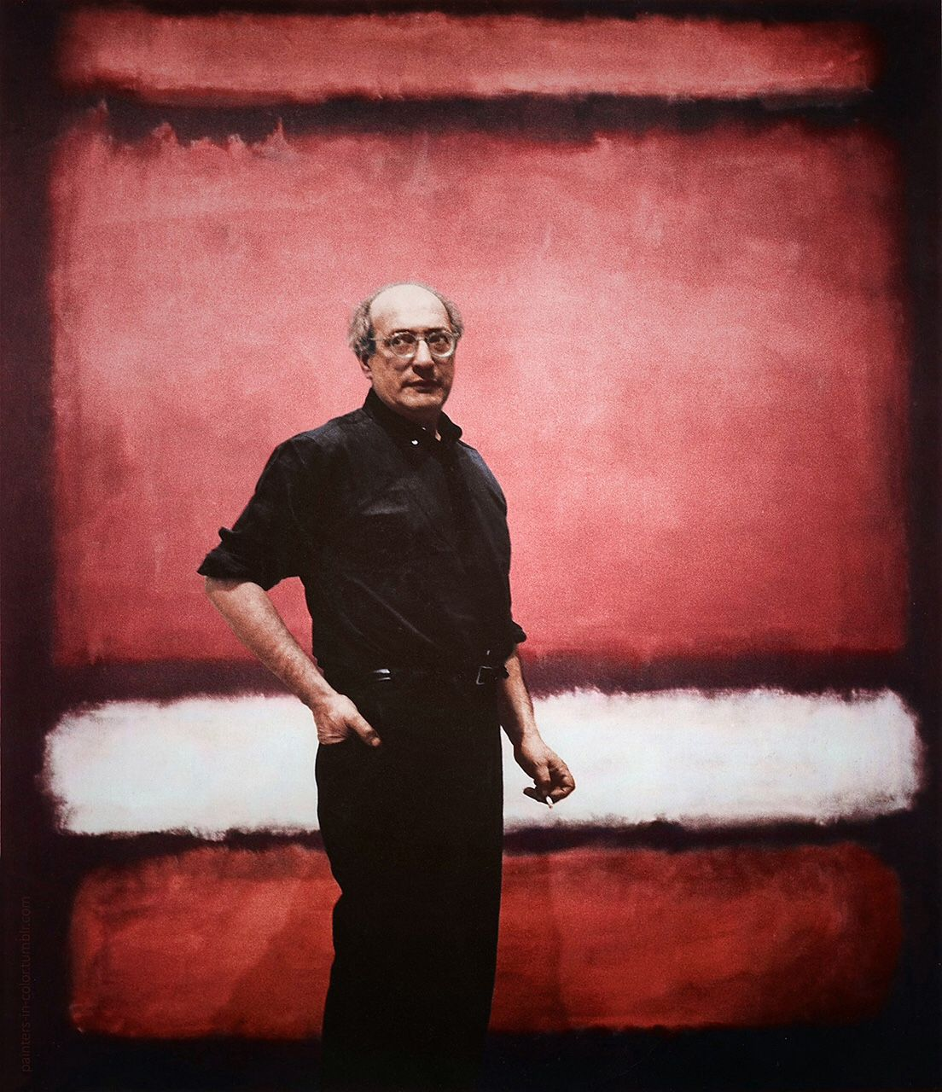
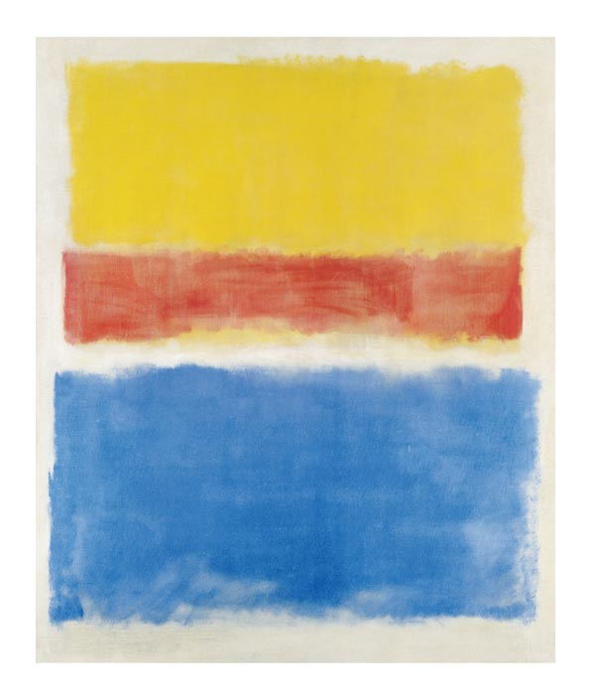
Mark Rothko was a leading figure in Abstract Expressionism, best known for his large-scale colour field paintings. His work uses blocks of glowing colour as a visual code to explore profound emotional and spiritual experiences. Rothko’s paintings are not just formal exercises—they are designed to evoke deep reflection, almost like meditative portals.
He believed that colour could communicate complex human states—grief, ecstasy, awe—without needing symbols or figures. The viewer’s emotional reaction was central to the meaning of his work.
Key Themes in Rothko's Work:
Exploration of mortality and the fragility of life.
Colour as a psychological and emotional code.
Simplicity of form to deepen viewer connection.
Meditation on themes of spirituality, mortality, and the sublime.
Intimacy and intensity through scale, hue, and softness of edge

Slide 7
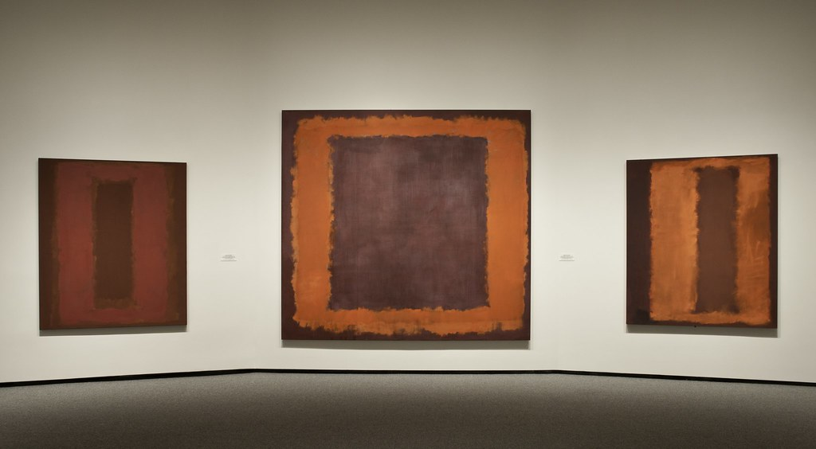
Inquiry Process:
Developing: How can colour alone create emotional depth?
Researching: Explores colour theory and psychological response
Reflecting: Strips art of narrative to focus on feeling
Resolving: Composition becomes meditative space for viewer experience
What emotion do you feel when looking at this?
MARK ROTHKO Reality Machines, 2016, installation
Formal Context: Rothko’s work is defined by formal elements such as colour, space, shape, and proportion. He carefully layered soft-edged, floating rectangles using glazes to create immersive canvases where colour becomes the language. Through limited palettes, rhythmic composition, and large scale, he evokes emotional resonance without the need for figures or narrative.
Cultural Context: Rothko’s work was shaped by post-war existentialism, ancient mythologies, and his experience as a Jewish immigrant. In the wake of WWII, he turned to abstraction to explore themes of trauma, loss, and the human search for meaning. He viewed colour as a universal language, capable of transcending cultural boundaries, offering his paintings as spiritual responses to a fractured and disillusioned world.

Slide 8

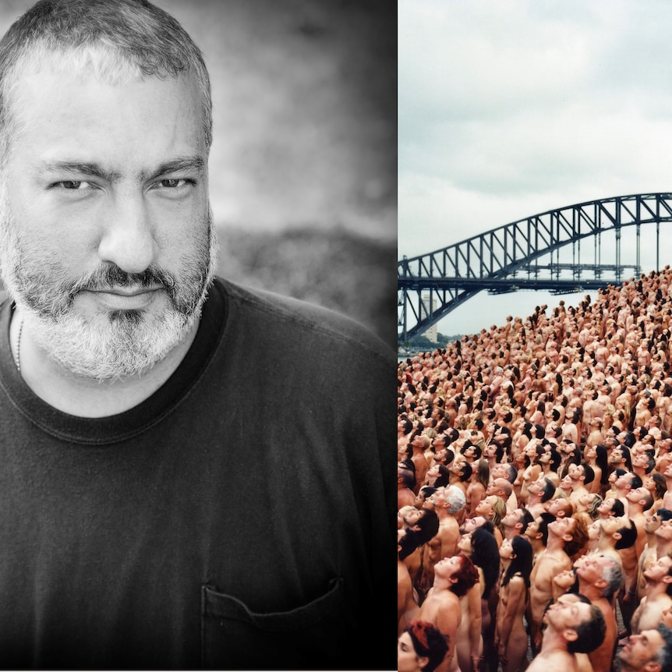
Spencer Tunick is an American contemporary artist renowned for his large-scale installations of nude human bodies arranged in public spaces. His work uses the body as a visual and symbolic code to explore ideas around vulnerability, collectivity, freedom, and resistance.
By removing clothing, Tunick strips away social identifiers like class, status, and fashion, presenting the nude body as raw material for constructing mass, form, and line. His installations are both aesthetic compositions and cultural interventions, often provoking debate about privacy, censorship, and body politics.
Key Themes in Tunick's Work:
The human body as a formal and political element.
Collective identity and the power of community.
Challenging public norms around nudity, consent, and space.
Environmental and cultural activism through large-scale performance

Slide 9
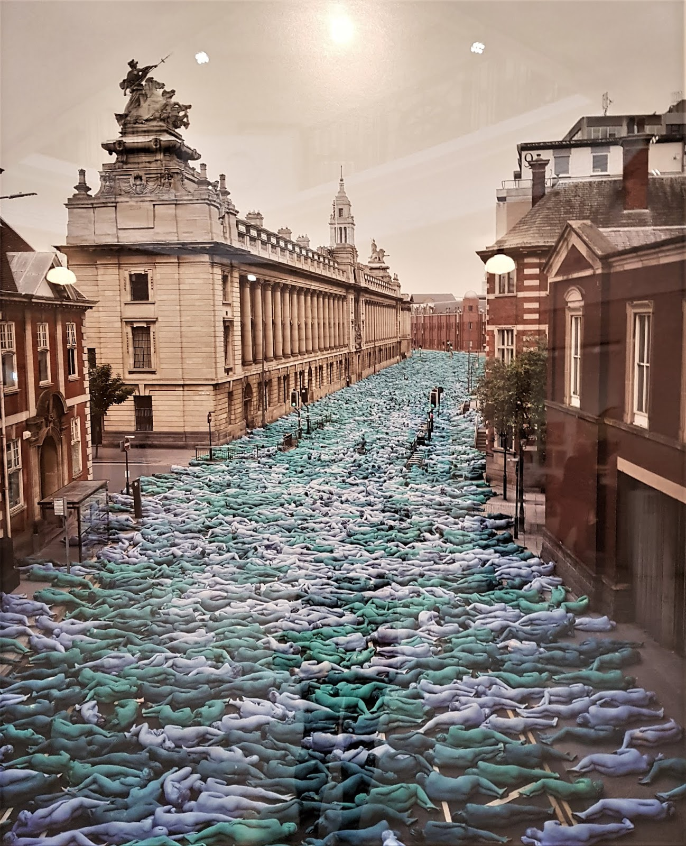
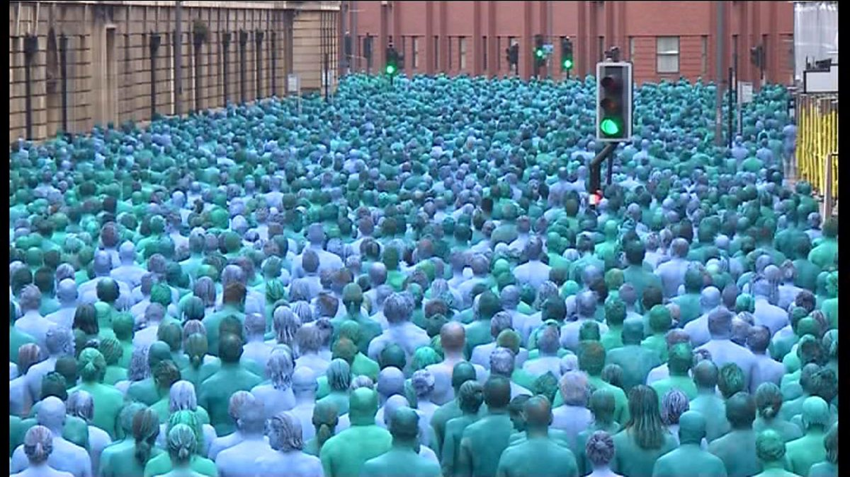
How does body colour change meaning?
Formal Context: Tunick uses repetition, rhythm, and spatial arrangement to compose large-scale images where bodies become abstract forms. The nude figure is treated as a visual unit—shaping patterns, creating texture, and forming harmonious or confrontational compositions. His aerial views flatten individual identity, focusing instead on collective shape and movement.
Inquiry Process:
Developing: How can human form be used as visual language?
Researching: Responds to city, sea, and social body
Reflecting: Uses community and spectacle to provoke dialogue
Resolving: Photography documents the ephemeral message
Cultural Context: Tunick’s work challenges cultural taboos around nudity and public space. He uses the body as a symbol of protest and freedom, often responding to issues like censorship, environmental concerns, and LGBTQIA+ rights. His installations act as visual statements, with participants coding their bodies into messages about equality, vulnerability, and community.

